Slide 1
MUSIC THROUGH SCILAB
By A.S.Ranade

Slide 2
Music notes
Simplest note : A pure sine wave of desired duration
Quality(Timbre) can be changed by
Adding harmonics
Multiplying by an envelope
Musical instrument manufacturers
High quality conventional instruments, Microphone, A/D converter
Notes:
When a note is obtained by addition of many signals of various frequencies the pitch corresponding to the highest amplitude will be detected by the ear.

Slide 3
Generating and playing a note
clear;
clc;
d = 1;
t = 0:1/22050:d;
x = sin(2*%pi*520*t);
sound(x);

Slide 4
Effect of downsampling
clear;
clc;
d = 1;
t = 0:1/44100:d;
x = sin(2*%pi*520*t);
sound(x);
The note will be of double duration and half frequency

Slide 5
Effect of upsampling
clear;
clc;
d = 1;
t = 0:1/11025:d;
x = sin(2*%pi*520*t);
sound(x);
The note will be of half duration and double frequency

Slide 6
Generating simple notes
clear;clc; d = 0.4;
t = 0:1/22050:d;
fs = 260;fr = 260*2^(2/12);fg = 260*2^(4/12);
Sa = sin(2*%pi*fs*t);
Re = sin(2*%pi*fr*t);
Ga = sin(2*%pi*fg*t);
C = [Sa Re Ga Re Sa];
sound(C);
Nr = length(Re); disp(Re(Nr)); disp(Ga(1));

Slide 7
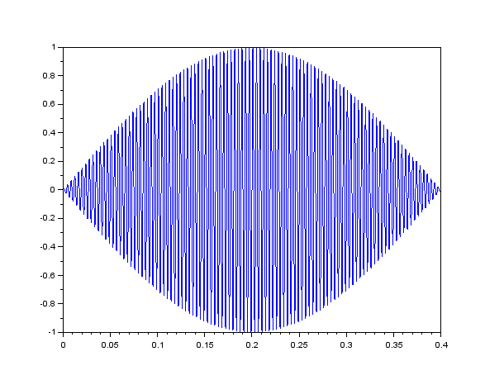
Envelope

Slide 8
Envelope generation
clear;clc;
d = 0.4;t = 0:1/22050:d;
fs = 260;
En = sin(%pi*t/d);
fr = 260*2^(2/12);
fg = 260*2^(4/12); Sa = En.*sin(2*%pi*fs*t);
Re = En.*sin(2*%pi*fr*t); Ga = En.*sin(2*%pi*fg*t); C = [Sa Re Ga Re Sa];
sound(C);

Slide 9
Note synthesis
Phase modulation of fundamental sine wave
Bell like sound
Adding harmonics to fundamental sine wave
Thinner sound
Envelope
Attack
Decay
Sustain
Release

Slide 10
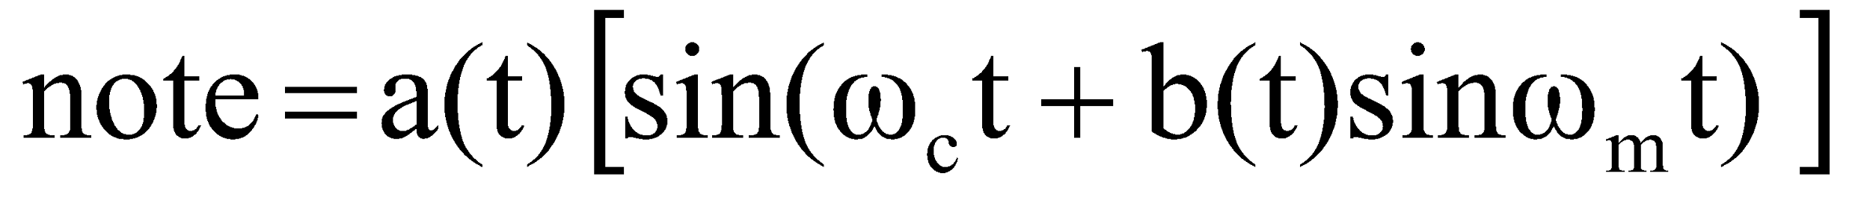
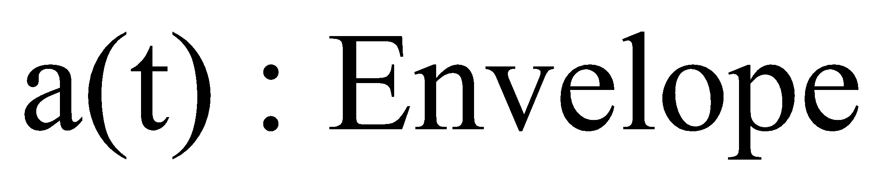
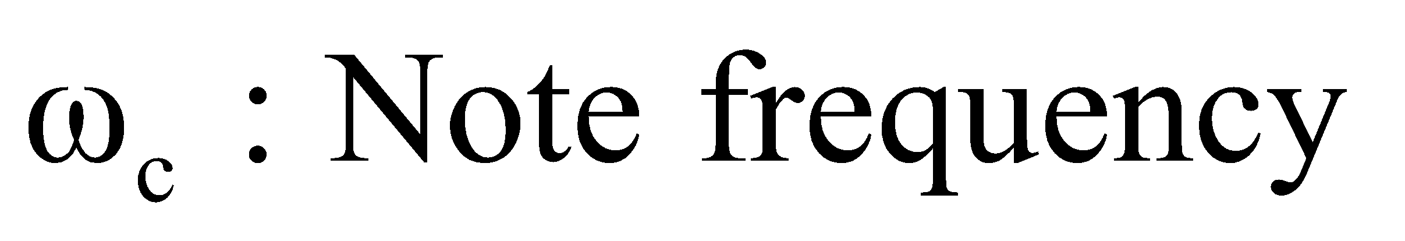
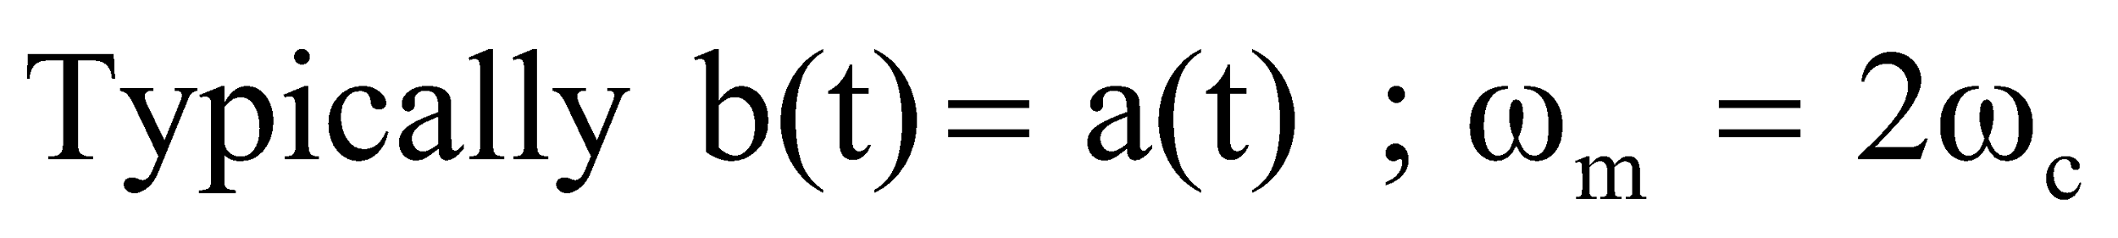
Amplitude and Phase modulation for music note synthesis

Slide 11
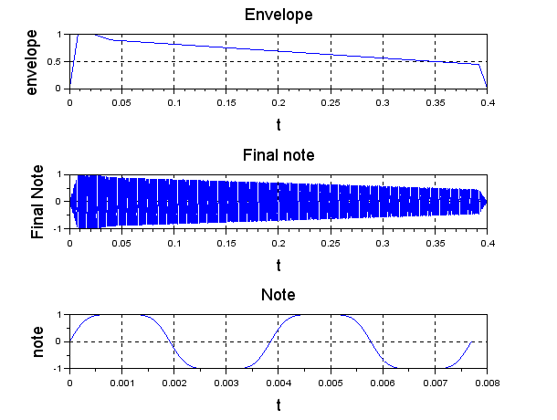
Bell sound waveforms

Slide 12
What frequencies?
Melody is a sequence of notes
What should be the ratio of frequencies of successive notes?
Pythagoras first showed that ratios of small integers sounded pleasant to the ear

Slide 13
Tempered scale
Natural scale
Ratio of consecutive notes not same
Design of harmonium or piano difficult
Tempered scale
Ratio of consecutive notes is kept same
2 ^{1/12}
Base note S1 = 260 Hz
R1 = 260x 2 ^{1/12} = 275.46 Hz

Slide 14
Tempered Scale
Western Notation | Indian Notation | Frequency ratio(Tempered)
C | Sa | 1
C# | Re | 2 ^{1/12}
D | Re | 2^{2/12}
Eb | Ga | 2^{3/12}
E | Ga | 2^{4/12}
F | Ma | 2^{5/12}
F# | Ma’ | 2^{6/12}
G | P | 2^{7/12}
Ab | Dh | 2^{8/12}
A | Dh | 2^{9/12}
Bb | Ni | 2^{10/12}
B | Ni | 2^{11/12}
C’ | Sa’ | 2/1

Slide 15
Frequencies
275.46 309.19 347.06 412.72 463.27
R1
G1
M1
D1
N1
G1
S1 R2 G2 M2 P D2 N2 S1t
260 291.84 327.58 367.69 389.56 437.27 490.81 520
M2

Slide 16
Three octaves (Saptaks)
These are defined relative to base note
Say f
Mandra saptak : f/2 to 2^{11/12}xf/2
Madhya Saptak : f to 2^{11/12}xf
Tar Saptak : 2f to 2^{11/12}x2f
Example (Frequencies are in Hz)
Mandra Saptak : 130 to 245.4
Madhya Saptak : 260 to 490.81
Tar Saptak : 520 to 981.63

Slide 17
Generation of musical note
function tone=noteG(s, n, d)
if s == 1 N = 2^(n/12);
elseif s == 2 N = 2*2^(n/12);
else N = 4*2^(n/12);
end
f = 130; f1 = f*N;
t = 0:1/22050:d;
a =0.8* exp(-t/1.5*d) ;
S = sin((2*%pi*f1*t + a.*sin(4*%pi*f1*t) ))
S = 0.25*S ;
tone = a.*S;
endfunction

Slide 18
Examples of note generation
d1 = 0.4;
Silence = 0*[0:1/22050:d1]
S1 = noteG(2,0,d1);
S1t = noteG(3,0,d1);
S1td = noteG(3,0, 2*d1);
R1 = noteG(2,1,d1);
R2 = noteG(2,2,d1);
G1 = noteG(2,3,d1);
G2 = noteG(2,4,d1);
M1 = noteG(2,5,d1);
M2 = noteG(2,6,d1);
P = noteG(2,7,d1); D1 = noteG(2,8,d1); D2h = noteG(2,9,d1/2);
N1 = noteG(2,10,d1); N2 = noteG(2,11,d1);

Slide 19
Bhoop
b1 = [S1t S1t D2d S1t S1t D2d P G2 R2 S1 G2 P D2d];
b2 = [Pd G2d Pd G2d R2 S1 R2d G2 D2 S1td];
b3 = [P G2 D2d P G2 R2 S1 P G2 D2d P G2 R2 S1]
b = [b1 b2 b3 b2];
sound(b);
wavwrite(b,‘bhoop.wav');

Slide 20
Generating ADSR
T = length(t); T1 = round(0.02*T);
T2 = round(0.04*T); T3 = round(0.88*T);
L1 = linspace(0,1,T1); L2 = linspace(1,1,T2);
L3 = linspace(1,0.9,T2); L4 = linspace(0.9, 0.45,T3); L5 = linspace(0.45,0,T1); a = [L1 L2 L3 L4 L5 ];
A = length(a); if T > A then diff = T-A; for i = 1:diff a = [a 0]; end elseif T < A then diff = A-T;
for i = 1:diff t = {t 0}; end end

Slide 21

Examples
Phase modulation synthesis
Additive Synthesis
Sustained sine wave

Slide 22
Important terms in Rhythm
Tempo
Note durations
Time Signatures

Slide 23
Tempo
Time reference required
Beats per minute
Tabla
Drum
Tempo
Slow : 40 to 75 bpm
Moderate : 70 to 115 bpm
Fast : 110 to 220 bpm

Slide 24
Tempo- Example
Tempo : quarter note 120 bpm
120
Quarter note lasts for 0.5 seconds
Half note lasts for 1 second
Whole note lasts for 2 seconds
Eighth note lasts 0.25 second
Sixteenth note lasts 0.125 second

Slide 25
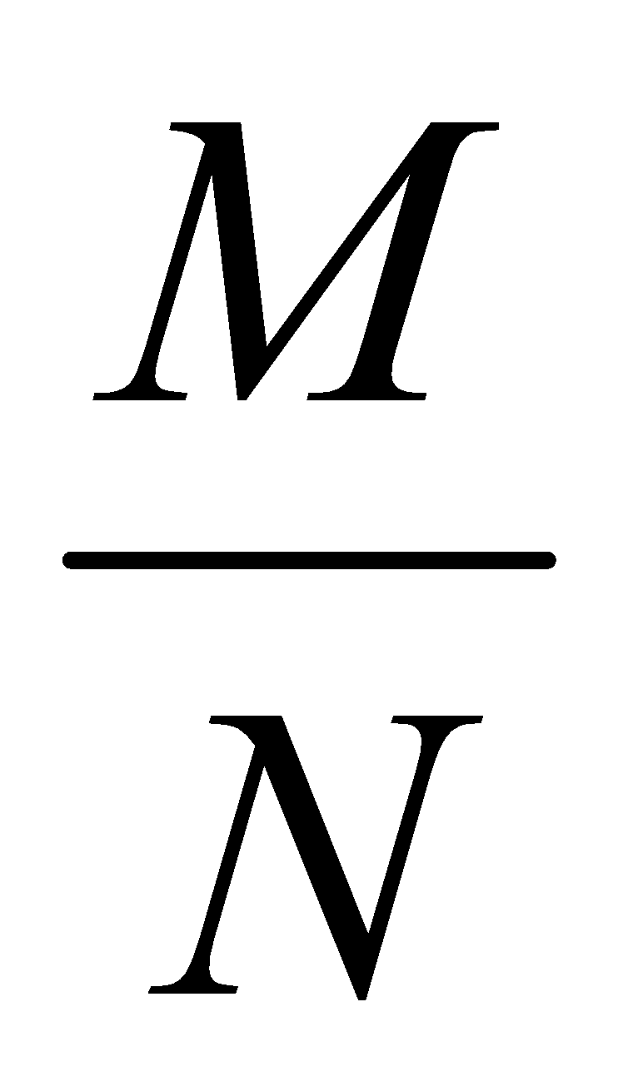
Rhythm : Time Signature
Each melodic phrase is subdivided into sections called measures
Measure is defined by Time signature
M denotes the number of beats in the measure
N denotes the type of the note
N = 4 : Quarter note
N = 2 : Half note

Slide 26
Rhythmic patterns for 4/4
Note durations are so selected that each measure occupies time corresponding to 4 quarter notes
BPM = 120
Quarter note duration
= 0.5 seconds
Measure Duration
2 seconds

Slide 27
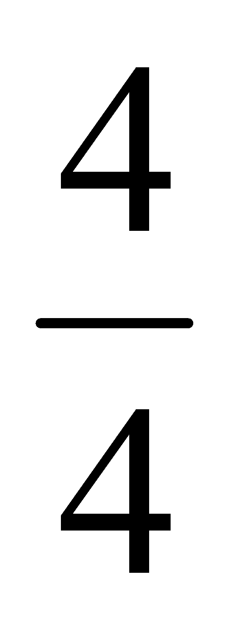
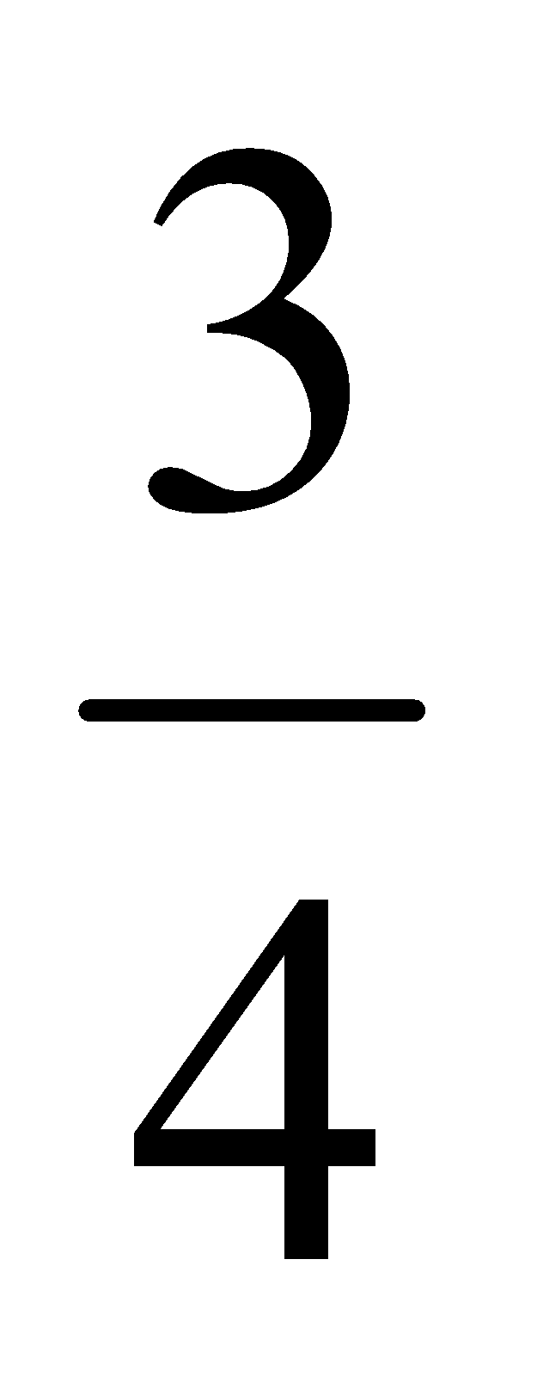
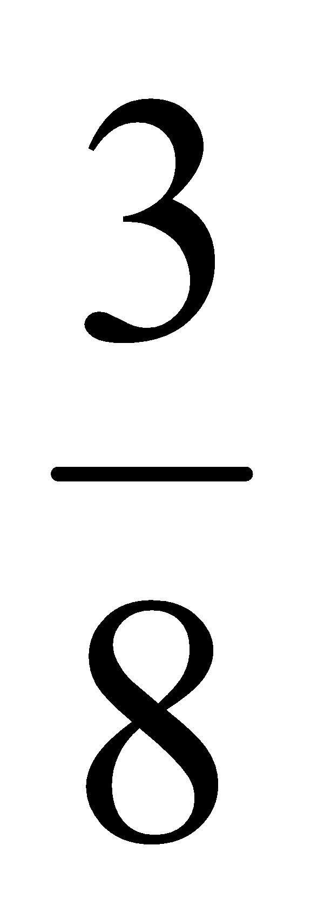
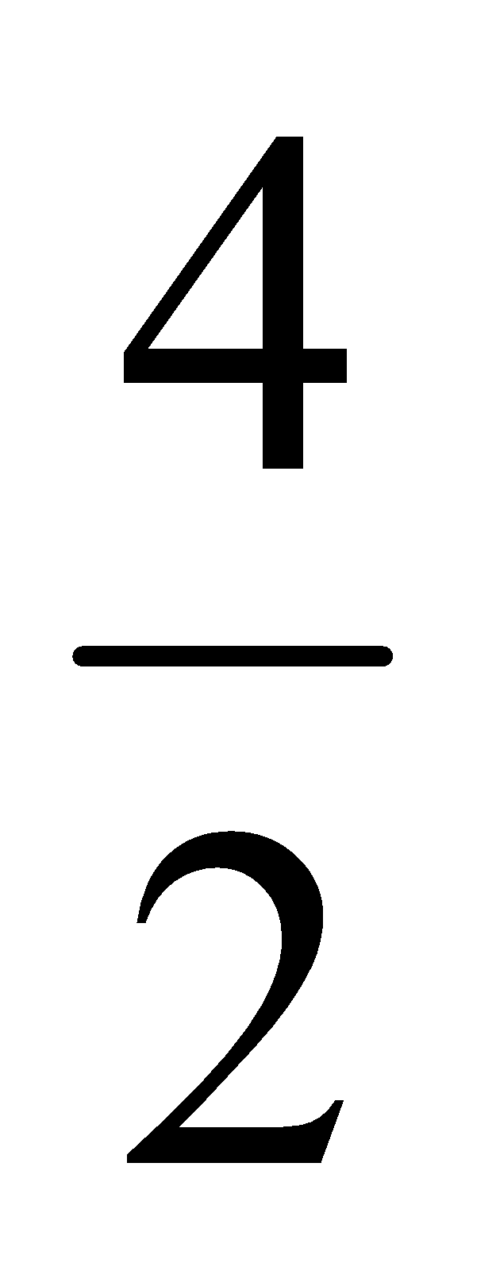
Time Signature Examples
Time Signature | Beats per measure

Slide 28
Structure of a song
Two structures
Lyrical structure
A number of lines
Each line is a sequence of words
Each word is a sequence of letters
Melodic Structure
A number of phrases
Each phrase is a sequence of measures
Each measure is a sequence of notes

Slide 29
Composition
Notes are selected from a scale or a raga
Each phrase consists of 2 or 4 or 8 or 16 measures typically
In a line there are typically ascending and descending notes
Usually there are small steps in the sequence
Repetitions and variety are used
Repetition of rhythm in a line
Repetition of a line itself.

